Slide 1


Swedish American Historical Society of Wisconsin, Inc.
2026 Annual General meeting
Welcome & Announcements
Holiday Folk Fair, November 20– 22, 2026, Wisconsin State Fair Park
December 13, 2026, at 2 PM, Lucia Celebration at Fox Point Lutheran Church, 7510 N Santa Monica Blvd, Fox Point, WI
Election of Directors
Quorum, nominations, election
Annual Reports
Secretary minutes from 2025 Annual meeting, 2026 reports: Treasurer, Membership, Publicity, Programs, Hospitality, Midsommar, Genealogy, Presidents. (All reports available on SAHSWI website).
Program
A tale of two Islands presented by Birgit Moxon
Fika
Coffee and treats the Swedish way

Slide 2
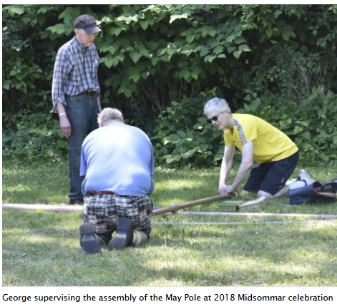
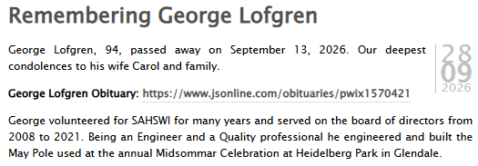
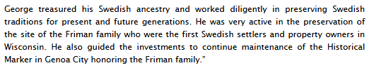
Bev Wenzel:

Slide 3

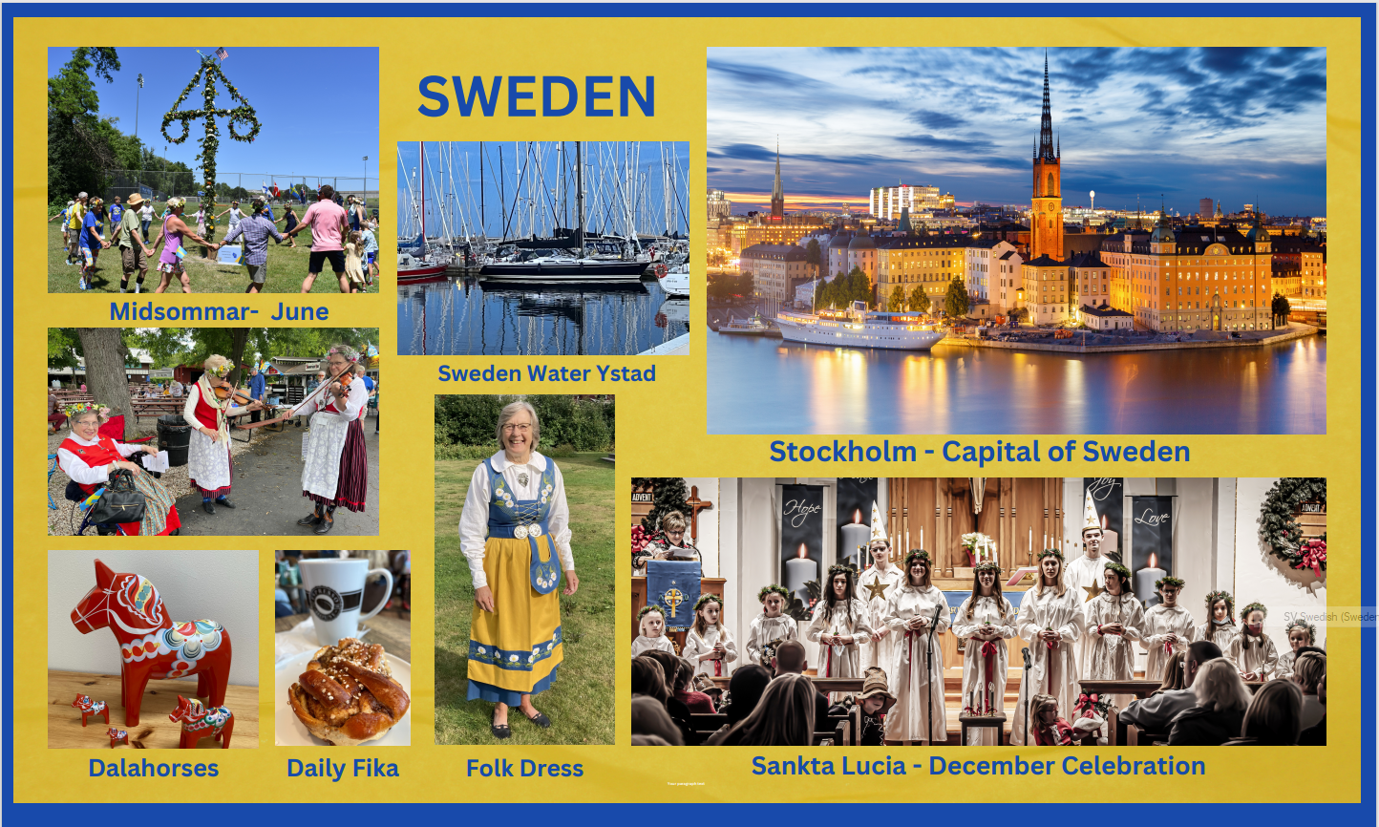
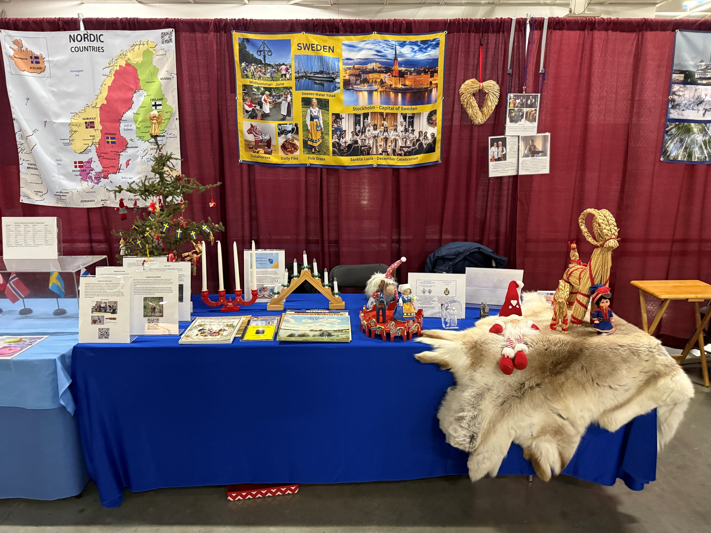
2026 Holiday Folk Fair International
Volunteer sign-up
Friday November 20
9 am to 1 pm | Liza Ekstrand, Jan Ehrengren, John Engel,
1 pm to 5pm
5 pm to 9 pm | Allan, Linda &Anja Stenmark
Saturday November 21
10 am to 1 pm | Cookie Anderson, Elaine Johnson
1 pm to 4 pm | Mary and Bob Stetson
4 pm to 9 pm | Marianne Ekstrand
Sunday November 22
10 am to 2 pm
2 pm to 6 pm | Lisa Ekstrand, Jan Ehrengren, John Engel

Slide 4
Election of Board Directors
Bylaws
Article 111 - Board of Directors
Membership: The Board of Directors shall consist of seven Society members, who shall be elected by the members of the Society at the Annual General Meeting thereof, plus the immediate Past President. If the immediate Past President is not available, one additional Board Member may be added if needed and subject to board approval. "Board" shall hereinafter be used to mean Board of Directors.
Terms: The term of each such elected Director shall be three years, to take effect upon the first meeting of the Board following the elections. Such meeting shall be called by the outgoing president, who will conduct the business of the meeting until new officers are elected by the Board. The terms shall be staggered so that terms ^{O}of two, two and three Directors shall expire in successive years.
October 2026 Newsletter
“Election of directors During the Annual Meeting, one director will be on the ballot. John Engel and Janet Taylor were appointed to be members of the nominating committee. Tracy Redman has completed a three-year term and has been nominated for re-election. In accordance with the bylaws, additional nominations may be made only by petition in writing by two or more Society members to the Secretary, along with written consent of each additional nominee, prior to the opening of the Annual General Meeting.”
Terms Expiring, Tracy Redman
Nominating Committee Nominees for a 3-year term, Tracy Redman,
Any other nominations from membership?

Slide 5
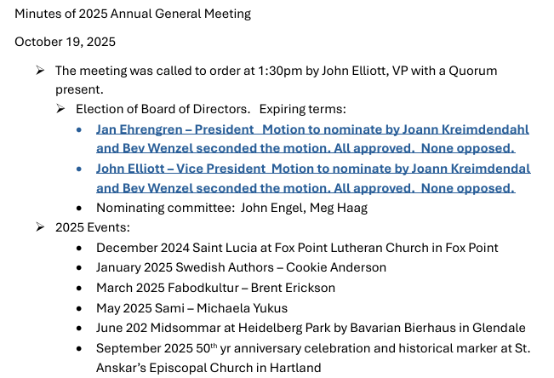
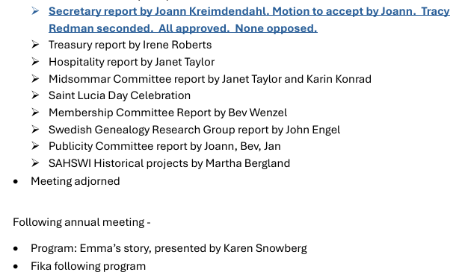
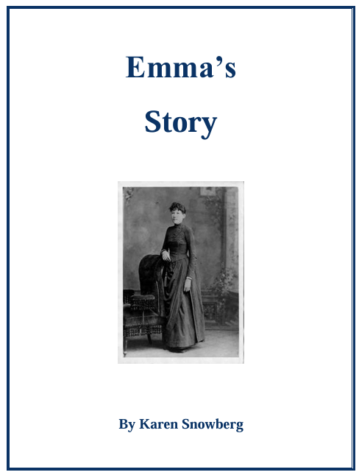
Secretary Report
Submitted by Tracy Redman, SAHSWI Secretary

Slide 6
Treasury Report
Submitted by Irene Roberts, SAHSWI Treasurer
Contact SAHSWI Secretary Tracy Redman for a copy of 2026 Officer and Committee Reports,
tracyredman1@gmail.com

Slide 7
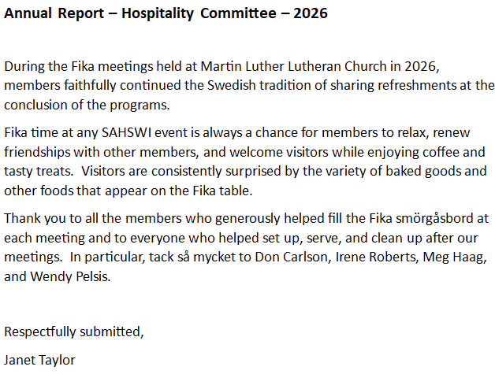
Hospitality Committee Report
Submitted by Janet Taylor, Committee Chair

Slide 8
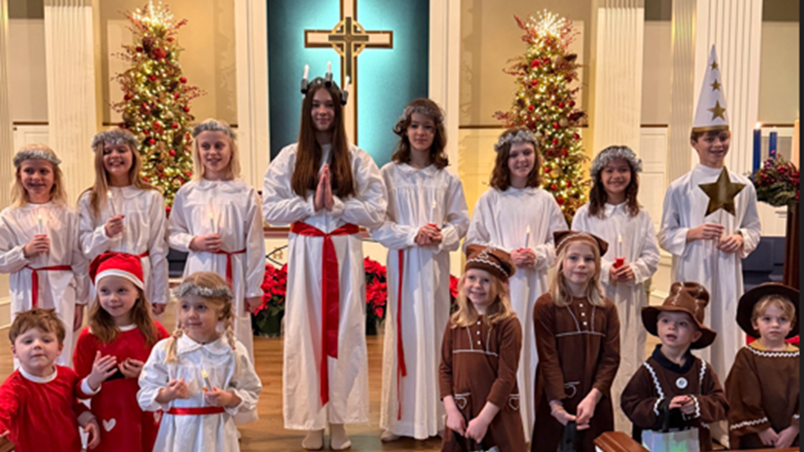
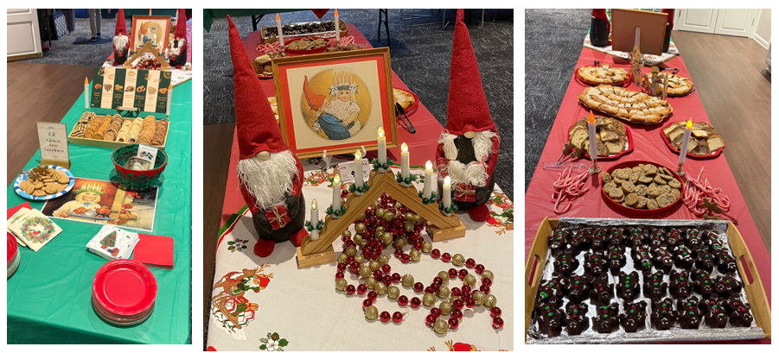
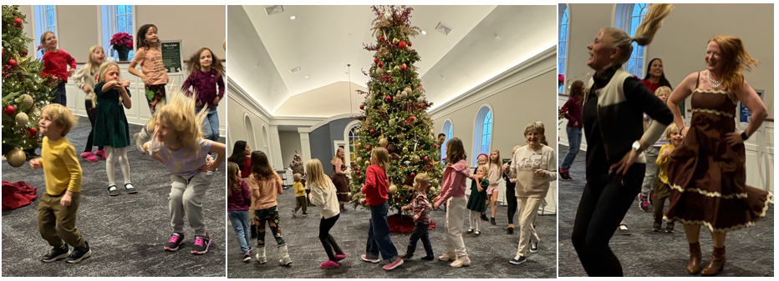
Lucia Committee report, Submitted by Jan Ehrengren
Lucia celebration was held on Sunday December 28 (rescheduled from Dec 14). Most of the participants in the Lucia program were able to join, and overall, about 80 people attended the event. The procession was led by 2025 Lucia Madeleine Franke, followed by attendants, Leighton Ehrengren, Kenzie Klagmann, Ida Knox*, Ella and Emilia Lemery, Mila Leon, Thea Quealy, Villa Sjöberg, Layla Gallo, Starboys Camden Ehrengren, Joseph Kaltenberg*, Olof Knox*, Gingerbread men Arlo Ehrengren, Eli Kaltenberg*, Nora, Isla and Wilam Thode-Edström, and Little Santas Astrid and Oskar Erkander*, and Nova and Orion Balistreri. (* missing due to re-schedule)
The Lucia program was directed by Stina Lemery, the Lucia Story and Song was introduced by Swedish School Teacher Amanda Balistreri, and the Piano was played by Matt Byczynski. The Lucia program included 9 well known Swedish Christmas songs, starting with Sankta Lucia and ending with Stilla Natt sung both in Swedish and English (Silent Night). The Lucia Crown includes 5 candles, and for each of the candles a poem was read by the program participants both in Swedish and in English and the candle was lit.
After the Lucia program Fika was served in the Fellowship Hall including coffee and Juices and cookies and pastries, a Cinnamon Kringle from O&H Bakery, 7 different cookies from Åsljunga, Sweden, Brownies shaped like a Gingerbread man baked by Kerri Ehrengren, and Chocolate Chip Cookies.
The final activity of the day was the traditional Dance Around the Christmas tree based on traditional Swedish song and dance.
We like to thank everybody involved and coming to the Lucia celebration ensuring this wonderful Swedish tradition is maintained. Our sincere thanks to Stina, Amanda and Matt and all the children for a beautiful perfect Lucia program, to Pastor Bill and Operations Director Kelly Price for having us at the church and for all the help and support, Kerri for all the preparations of the Fika, Wendy Pelsis and Joann Kreimendahl for serving the welcome table, Bev Wenzel for preparing printed programs and sign-up sheets and everybody that was helping with the setup, takedown and cleanup of the Fika.

Slide 9
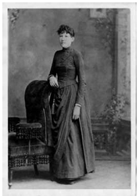
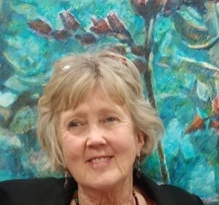
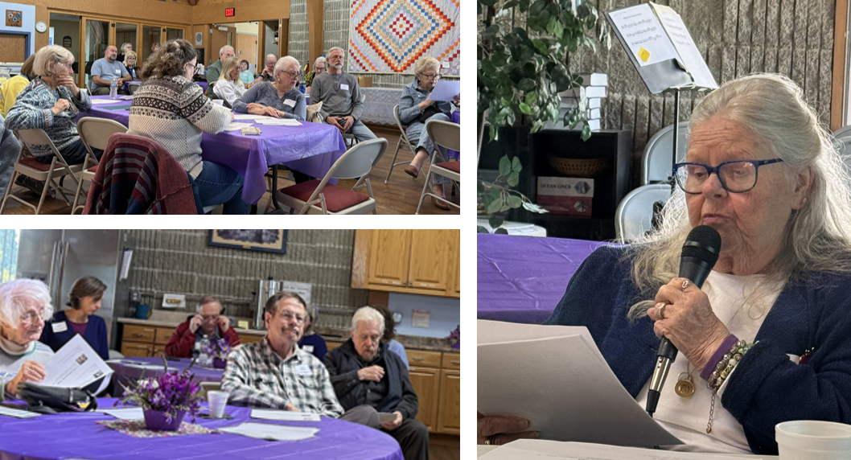
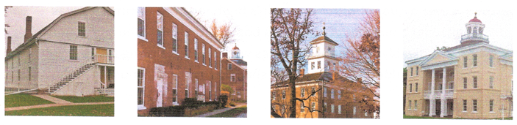
Swedish American Historical Society of Wisconsin, Inc. 2026 Fika Programs
October 2025
January 2026
Program: Karen Snowberg presented her story about Emma, her grandmother, who in 1882 left Sweden to settle in Minnesota. This story is about Emma’s life in Sweden and in America and is based on significant research by Karen and her extended family both in Sweden and USA.
Program: Somewhere in England presented by member Sherry Engstrom. A story, show and tell and narrative of her two Swedish-American parents and their WW II love letters and resulting 70 year marriage.
March 2026
May 2026
September 2025
Lucia celebration
The Fika meeting featured Award–winning Author Martha Bergland and her Husband Jim Uhrinak presentation about their visit to Bishop Hill.
Program: Swedish Film. Member Cookie Anderson discussed famous Swedish Film Directors and Movie Makers including information about the movies they directed.
Fäbodkultur
Midsommar 20252 2025

Slide 10
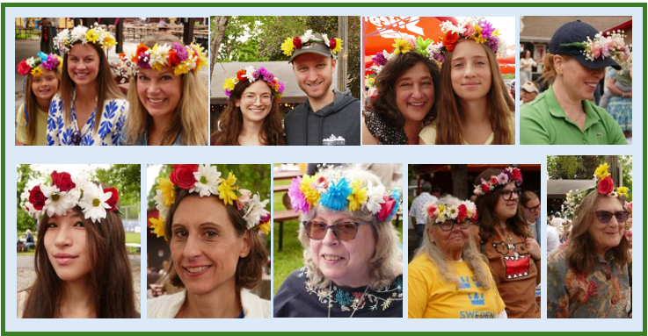
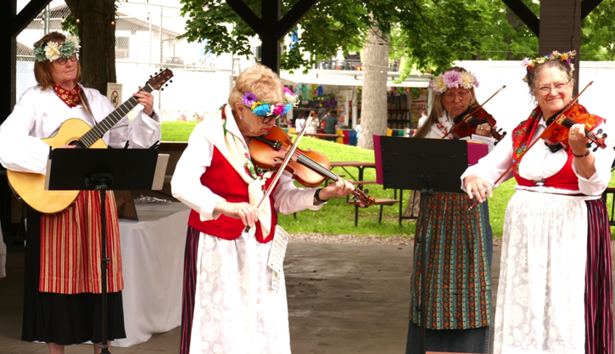
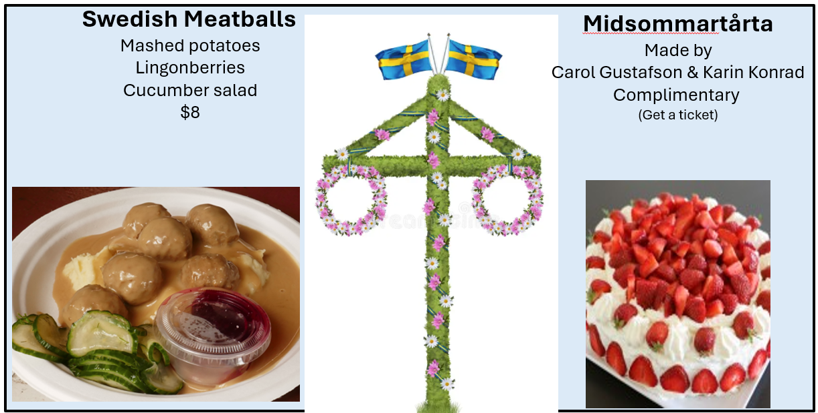
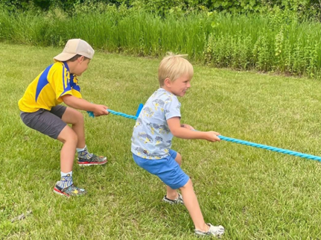
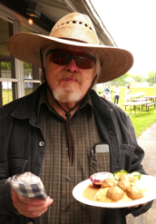
Midsommar Committee Report Submitted by Jan Ehrengren
Midsommar 2026 was celebrated Sunday, June 21, 2026, 11 AM – 2 PM at Heidelberg Park by Bavarian Bierhaus in Glendale.
The Flower Crowns: Making and then wearing a flower crown is one of the most favorite activities during Midsommar celebration. SAHSWI member Karin Konrad prepared and was leading this activity.
Swedish Folk Music and Scandinavian Folk Dance: Everybody enjoyed the popular violin and guitar group Goda Vänner playing traditional Swedish Folk music, and the Lykkeringen dancers performing Scandinavian Folk Dances.
The Food: Carol Gustafson’s ensured The meatball dish was back on the menu and consumed by grateful celebration attendants, actually they sold out early. Carol also teamed up with Karin Konrad and baked cake and offered a piece of Midsommartårta.
Kubb and Activities for the Children: Children could enjoy Sac Raises, Tug a War, and Corn Hole game, and Face painting and Crafts. As is tradition at Midsommar some participants played a game of Kubb set-up and supported by SAHSWI Vice President John Elliott.
Swedish-American History and Genealogy: Much of the activies of the Swedish American Historical Society of Wisconsin relates to History of Swedish immigration to Wisconsin, two stations were set up to learn about these topics. Martha Bergland and her husband Jim Uhrinak were managing the History station focusing this year on information about Bishop Hill, which was a Swedish colony established by Erik Janson and his followers, the religious sekt Jansonists in 1846. John Engel, SAHSWI Board member and the leader of the Swedish Genealogy Research Group, managed the Genealogy station and answered questions and discussed ways to research family heritage.
Tack så mycket, Tusen tack, Thanks to all volunteers that made the Midsommar Celebration great
Emceeing and making all announcements. Tim Redman.
Welcome desk: Susan and Del Worden, Tracy Redman, Preparation by Bev Wenzel
Midsommar Pole assembly and decoration: Erik Ehrengren, Liza Ekstrand, Tim Redman, Rudy and Karin Konrad
Leading dance around the Midsommar Pole: Amanda Balistreri
Flowercrowns: Karin Konrad, Cookie Anderson and grandchild.
Swedish Folk music, Goda Vänner: Carol Gustafson, Mary Stetson, Eva Christensen and Patty Horn
Scandinavian Folk Dance: Lykkeringen Dancers: Lizabeth Bjork, Seija Freiberg, Chris Hansen, Doug and Joelle Freiberg, Kari Toth Steve Burghardt, Ann LeBaron, Philip Reikdahl, Robert and Caroline Sanders.
Childrens games, crafts and face painting: Camden Ehrengren, Danielle Jackson, Kris Laufer, and Elisabeth Elliott.
Scandinavian and American Flags: Rolf and Liza Ekstrand
Photographers: Bob Stetson, Lisa Kaltenberg (videos)
Kubb Game: John Elliott

Slide 11
2026 Membership Committee Report
SAHSWI Membership Committee
Maintains
  Records of current contact information for all SAHSWI members and forwards member interest in volunteering within the Society. ·
  SAHSWI email account inbox at swedishhistoricalwisc@gmail.com directing incoming message to appropriate Board, Committee or Society member for assistance.
Welcome Table:
  Prepares name tags and distributes to welcome members at meetings and provides count of total members present..
New Members:
  Provides letter of welcome explaining goals and providing further SAHSWI information and opportunities.
We thank and appreciate all who are helping or have in the past. Please consider volunteering your assistance on the Membership Committee or any area within SAHSWI, please contact Bev at 262-781-6113 or the society email account at swedishhistoricalwisc@gmail.com
Respectfully submitted,
Bev Wenzel, Membership Committee Secretary, Retiring

Slide 12
2026 Swedish Genealogy Research Group report – Submitted by John C. Engel
In 2026 we have explored the following:
Sharing and reserving an ancestor’s story, photos, and document images on Find A Grave, for free! https://www.findagrave.com
AI is arriving to help you with your genealogy research in exciting ways.
Finding your ancestors in ship passenger lists, with a special focus on Ellis Island,
Researching the background of your ancestor’s parish in Sweden,
Explored in detail the Mormon familysearch.org website because it offers so much to our members for both Swedish and U.S. research, at no charge.
Best, John

Slide 13
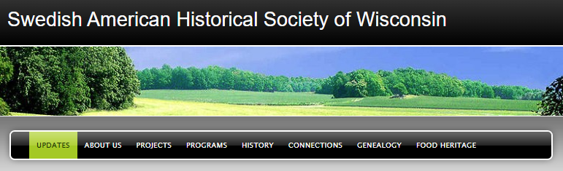
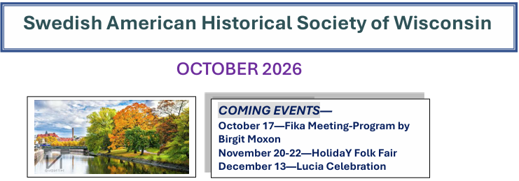
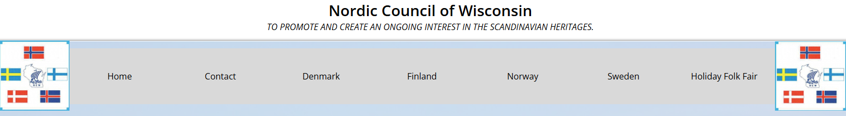
Publicity Committee 2026
SAHSWI Website www.sahswi.org provides
Information to the public about SAHSWI and Swedish American immigration to WI history
Invitations to the public to all SAHSWI events
18 Posts or blogs, 254 subscribers
3,634 visitors and 6,203 views in 2026
SAHSWI Newsletter
5 Newsletters edited and distributed by Joann Kreimendahl
Other publicity
Two mailings per year distributed to prospective member list (see also membership)
Updates to Nordic Council members organizations Home (nordiccouncil.com)
Website
Newsletter

Slide 14
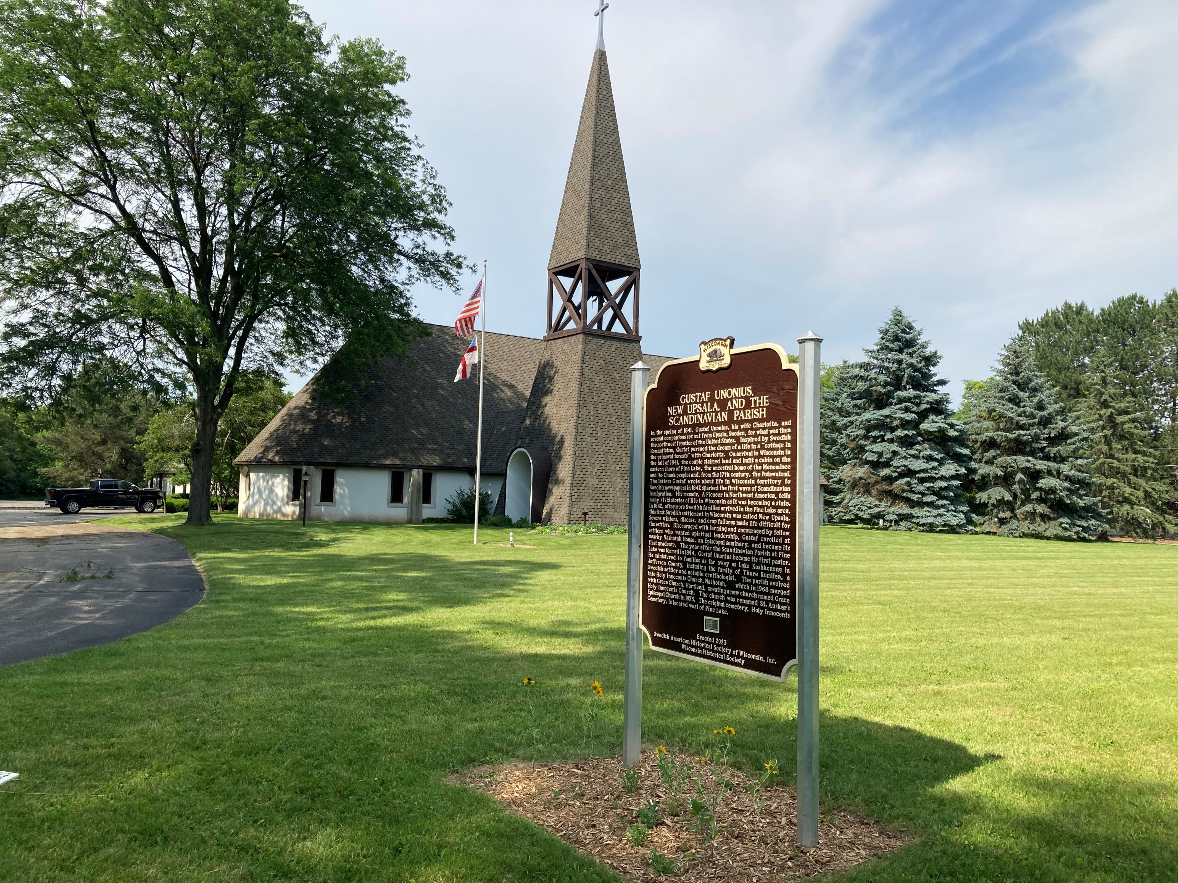
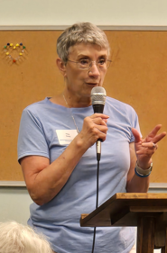
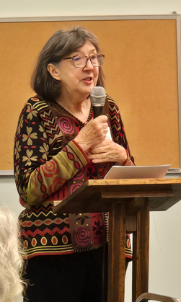
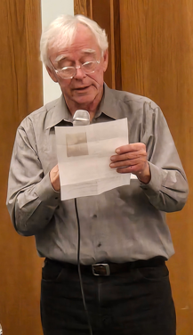
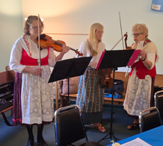
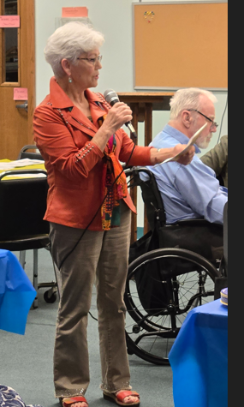
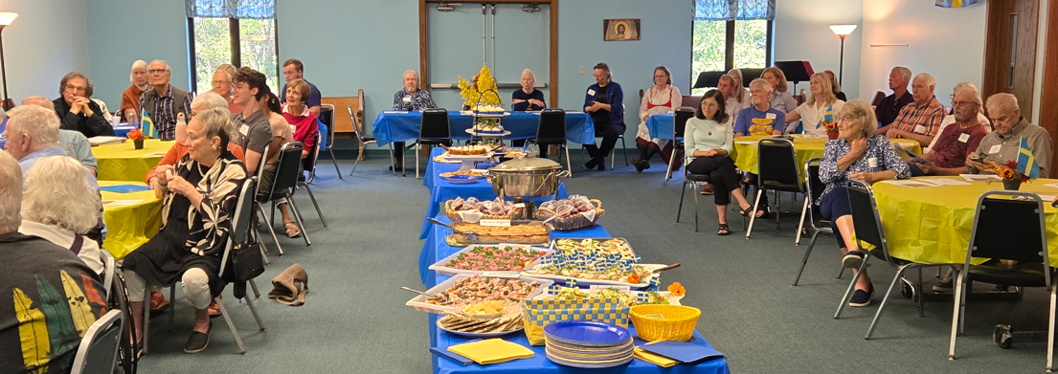
SAHSWI Historical Projects
Unonius, New Upsala and the Scandinavian Parish State Historical Marker
It was decided to honor Gustaf Unonius, New Upsala and The Scandinavian Parish Historical marker with an annual event.
This event Originally scheduled September 19, 2026 was cancelled, however, it is planned to continue this annual event at St. Anskar’s Episcopal Church in Hartland.
Pictures from 2025
event

Slide 15

Thank you!

Slide 16
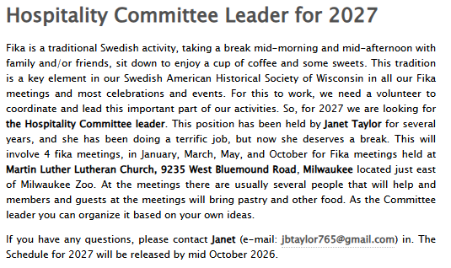

Slide 17
